Slide 1
CS4038
DATA MINING
LECTURE # 09
Spring 2024
FAST – NUCES, CFD CAMPUS
AYESHA LIAQAT
ayesha.liaqat@nu.edu.pk

Slide 2
TODAY’S TOPICS
Supervised Learning: basics
Classification
Model overfitting
Balancing the train dataset

Slide 3
AN EXAMPLE APPLICATION
An emergency room in a hospital measures 17 variables (e.g., blood pressure, age, etc.) of newly admitted patients.
A decision is needed: whether to put a new patient in an intensive-care unit.
Due to the high cost of ICU, those patients who may survive less than a month are given higher priority.
Problem: to predict high-risk patients and discriminate them from low- risk patients.

Slide 4
ANOTHER APPLICATION
A credit card company receives thousands of applications for new cards. Each application contains information about an applicant,
age
marital status
annual salary
outstanding debts
credit rating
etc.
Problem: to decide whether an application should be approved, or to classify applications into two categories, approved and not approved.

Slide 5
MACHINE LEARNING AND OUR FOCUS
Like human learning from past experiences.
A computer does not have “experiences”.
A computer system learns from data, which represent some “past experiences” of an application domain.
Our focus: learn a target function that can be used to predict the values of a discrete class attribute, e.g., approve or not-approved, and high-risk or low risk.
The task is commonly called: Supervised learning, classification, or inductive learning.

Slide 6
THE DATA AND THE GOAL
Data: A set of data records (also called examples, instances or cases) described by
k attributes: A₁, A₂, … A_{k}.
a class: Each example is labelled with a pre-defined class.
◾
Goal: To learn a classification model from the data that can be used to predict the classes of new (future, or test) cases/instances.

Slide 7
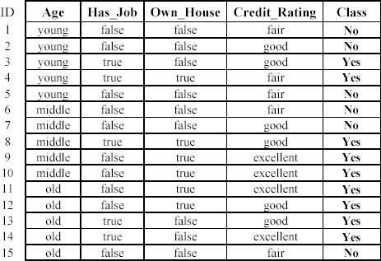
AN EXAMPLE: DATA (LOAN APPLICATION)
Approved or not

Slide 8
SUPERVISED VS. UNSUPERVISED LEARNING
Supervised learning: classification is seen as supervised learning from examples.
Supervision:The data (observations, measurements, etc.) are labeled with pre- defined classes. It is like that a “teacher” gives the classes (supervision).
Test data are classified into these classes too.
Unsupervised learning (clustering)
Class labels of the data are unknown
Given a set of data, the task is to establish the existence of classes or clusters in the data

Slide 9
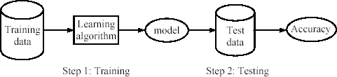
SUPERVISED LEARNING PROCESS:TWO STEPS
Learning (training): Learn a model using the training data
Testing: Test the model using unseen test data to assess the model accuracy
A performance measure

Slide 10
WHAT DO WE MEAN BY LEARNING?
Given
a data set D,
a task T, and
a performance measure M,
a computer system is said to learn from D to perform the task T if after learning the system’s performance on T improves as measured by M.
In other words, the learned model helps the system to perform T better as compared to no learning.

Slide 11
AN EXAMPLE
Data: Loan application data
Task: Predict whether a loan should be approved or not.
Performance measure: accuracy.
No learning: classify all future applications (test data) to the majority class (i.e.,Yes): Accuracy = 9/15 = 60%
We can do better than 60% with learning.
Consider no learning model as “baseline model”. Does your model perform better than 60%?

Slide 12
CATCHING TAX-EVASION
Tid | Refund | Marital Status | Taxable Income | Cheat
1 | Yes | Single | 125K | No
2 | No | Married | 100K | No
3 | No | Single | 70K | No
4 | Yes | Married | 120K | No
5 | No | Divorced | 95K | Yes
6 | No | Married | 60K | No
7 | Yes | Divorced | 220K | No
8 | No | Single | 85K | Yes
9 | No | Married | 75K | No
10 | No | Single | 90K | Yes
Tax-return data for year 2011
A new tax return for 2012 Is this a cheating tax return?
Refund | Marital Status | Taxable Income | Cheat
No | Married | 80K | ?
10
10
An instance of the classification problem: learn a method for discriminating between records of different classes (cheaters vs non-cheaters)

Slide 13
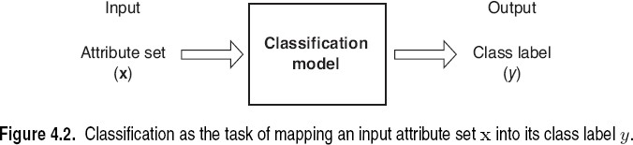
WHAT IS CLASSIFICATION?
Classification is the task of learning a target function f that maps attribute set x to one of the predefined class labels y
categorical
categorical
continuous
class
Tid | Refund | Marital Status | Taxable Income | Cheat
1 | Yes | Single | 125K | No
2 | No | Married | 100K | No
3 | No | Single | 70K | No
4 | Yes | Married | 120K | No
5 | No | Divorced | 95K | Yes
6 | No | Married | 60K | No
7 | Yes | Divorced | 220K | No
8 | No | Single | 85K | Yes
9 | No | Married | 75K | No
10 | No | Single | 90K | Yes
One of the attributes is the class attribute In this case: Cheat
Two class labels (or classes):Yes (1), No (0)

Slide 14
WHY CLASSIFICATION?
The target function f is known as a classification model
Descriptive modeling: Explanatory tool to distinguish between objects of different classes (e.g., understand why people cheat on their taxes)
Predictive modeling: Predict a class of a previously unseen record

Slide 15
EXAMPLES OF CLASSIFICATION TASKS
Predicting tumor cells as benign or malignant
Classifying credit card transactions as legitimate or fraudulent
Categorizing news stories as finance, weather, entertainment, sports, etc
Identifying spam email, spam web pages, adult content
Understanding if a web query has commercial intent or not
Binary vs. Multi-class classification problems

Slide 16

ILLUSTRATING CLASSIFICATION TASK
Tid | Attrib1 | Attrib2 | Attrib3 | Class
1 | Yes | Large | 125K | No
2 | No | Medium | 100K | No
3 | No | Small | 70K | No
4 | Yes | Medium | 120K | No
5 | No | Large | 95K | Yes
6 | No | Medium | 60K | No
7 | Yes | Large | 220K | No
8 | No | Small | 85K | Yes
9 | No | Medium | 75K | No
10 | No | Small | 90K | Yes
Learning algorithm
Induction
Learn Model
10
Training Set
Model
Apply Model
Tid | Attrib1 | Attrib2 | Attrib3 | Class
11 | No | Small | 55K | ?
12 | Yes | Medium | 80K | ?
13 | Yes | Large | 110K | ?
14 | No | Small | 95K | ?
15 | No | Large | 67K | ?
Deduction
10
Test Set

Slide 17
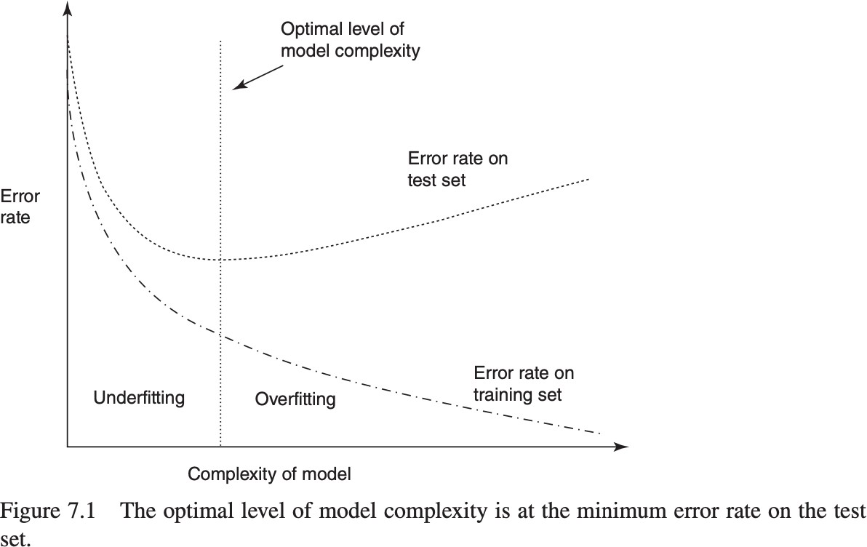
MODEL OVERFITTING

Slide 18
BALANCING THE TRAINING DATA SET
For classification models, in which one of the target variable classes has much lower relative frequency than the other classes, balancing is recommended.
Example: we are running a fraud classification model and our training data set consists of 100,000 transactions, of which only 1000 are fraudulent.
Our classification model could simply predict “non-fraudulent” for all transactions and achieve 99% classification accuracy.

Slide 19
BALANCING THE TRAINING DATA SET
Two ways to balance the training dataset:
Resample a number of fraudulent (rare) records.
Set aside a number of non-fraudulent (non-rare) records.
CAVEAT: The test data set should never be balanced.

Slide 20
READING MATERIAL
Chapter 4:Tan, Steinbach & Kumar
Chapter 8: Han, Kamber & Pei
22

